Slide 1
Clock Domain Crossing (CDC)
K.LOKESH
Chipweave Technologies Private Limited

Slide 2
In VLSI design, clock domain crossing (CDC) refers to the process of transferring a signal or data between circuits operating under different clock frequencies or sources.
This is a crucial but challenging task because different clock domains introduce asynchronous relationships, potentially leading to errors and malfunctions.
Clock Domain Crossing (CDC) is The process of passing a signal or vector (multi bit signal) from one clock domain to another clock domain.

Slide 3
Why is CDC important in VLSI?
Modern VLSI systems often integrate multiple functional blocks, each with its own optimal clock frequency for performance and power efficiency.
This creates the need for data exchange between these domains, necessitating proper CDC techniques. Without it, issues like:
  Metastability: Flip-flops can enter an unstable state where they oscillate between logic values due to setup/hold time violations from asynchronous signals. This can lead to unpredictable outcomes and circuit malfunctions.
  Glitches: Asynchronous transitions can create short-lived spurious changes in signal values, confusing downstream logic.
  Data loss: Timing mismatches can result in losing data transitions or sampling incorrect values.

Slide 4
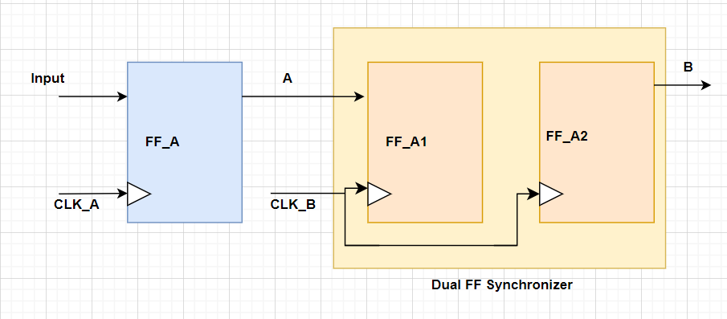
Clock Domain Crossing (CDC) Techniques
To address these challenges, various CDC techniques exist to handle data transfer between clock domains:
  One of the most common way to handle CDC is usage of synchronizer circuits.
  Synchronizer circuits: These use multiple flip-flops (commonly two) to re-sample the incoming signal in the destination clock domain, significantly reducing the probability of metastability.

Slide 5
Clock Domain Crossing (CDC) Techniques
In this two flip flops are connected in series, with the second acting as a backup for the first. If the first flip flop encounters data issues like setup/hold violations and enters a metastable state (uncertain logic level), the second flip flop has additional time for the first one to stabilize. Only the output of the second flip flop is used by the receiving logic.
Limitations: While effective for most designs, there's a small chance the first flip flop remains metastable when the second samples, potentially causing errors. This risk increases with very high clock frequencies.
Solutions: For better protection at high speeds, consider these options:
  Special library cells: Technology libraries may offer dedicated cells optimized for synchronization.
  More flip flop stages: Using 3 or 4 flip flops in series further reduces the risk of metastable propagation.

Slide 6
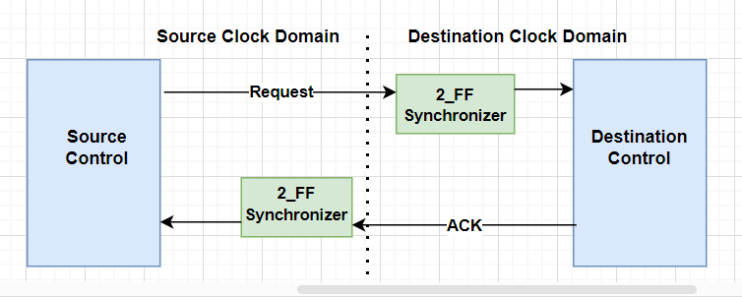
Clock Domain Crossing (CDC) Techniques
Handshake CDC: This technique employs control signals like "request" and "acknowledge" to ensure proper synchronization.
The source domain sends a request, waits for the destination's "ack," then transmits the data. This guarantees the destination is ready before receiving the data.

Slide 7
Clock Domain Crossing (CDC) Techniques
The above mechanism does have one drawback in terms of bandwidth usage of the interface.
The handshake technique can limit the bandwidth of the interface because the data bus cannot be updated while the "ack" signal is being received to overcome this issue we use asynchronous FIFO based CDC method.
Asynchronous FIFOs:
  This Clock Domain Crossing (CDC) technique requires a dual port SRAM, a source control block which controls the write pointer (address where the data should be written in SRAM), a destination control block which generates the read pointer (address where the data should be read in SRAM) and binary to gray encoder blocks along with 2-FF synchronizer circuits.

Slide 8
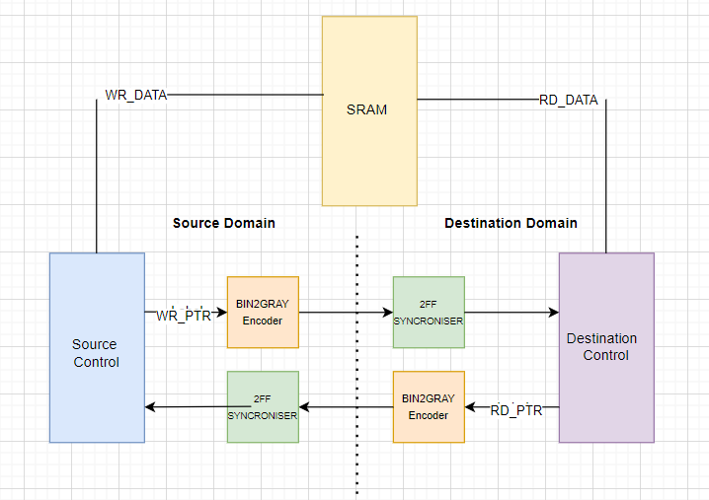
Clock Domain Crossing (CDC) Techniques
The pointers are managed as circular buffer by respective control blocks. However, to know when to write (FIFO not being FULL) and when to read (FIFO not being empty), the source and destination control blocks need to have a view of read and write pointers respectively.

Slide 9
Clock Domain Crossing (CDC) Techniques
Transferring of the pointers to another clock domain is not straight forward. Since pointer is a multibit signal so using a 2-FF synchronizer directly is not an option. For this reason, both pointers are passed through a Binary to Gray Encoding block. This makes sure that values when transferred, only one bit of the vector gets updated from one clock to another clock and thus eliminates the problem of synchronizing multibit bus on a clock edge.

Slide 10
Clock Domain Crossing (CDC) Techniques
Eliminate the combinatorial paths between two clock domains when signal is transferred from one clock domain to another clock domain.
FFs forming the synchronizer circuits must be placed closed to each other to allow smallest possible clock skew between them.
Never synchronize the same signal in more than one place.
Do not use Dual FF synchronizer scheme for a bus of data. Use handshaking technique.
It is good to invest time in good CDC design techniques rather than spending time in debug. CDC issues are very hard to debug to start with.

Slide 11
Thank You !

